Slide 1
Topic 6 - The Best Selection
General Outcome #1:
Explain why diversity aids in species survival.
Can I describe the process of natural selection?
General Outcome #3:
Describe the role of genetic material and biotechnology
Can I describe the process of artificial selection as a biotechnology?

Slide 2
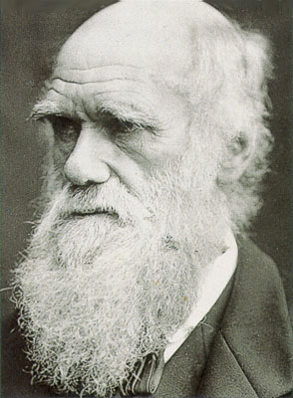
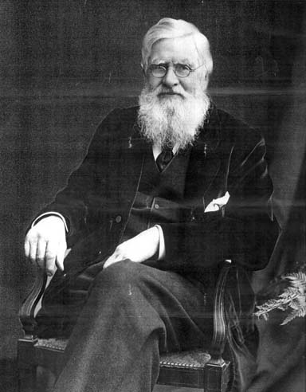
Natural Selection
Charles Darwin developed the theory of natural selection in 1831. Alfred Wallace also made similar conclusions but Darwin published Origin of a Species first so he is often credited with the idea.
Charles Darwin
Alfred Russel Wallace

Slide 3
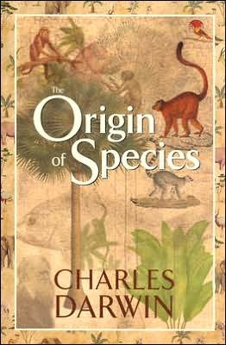
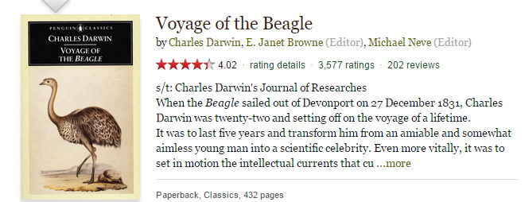
Charles Darwin
Alfred Russel Wallace

Slide 4
Nature determines which animals and plants will be able to reproduce and spread their characteristics. Environmental conditions, food sources, and predators eliminate the organisms who are less equipped to survive.
“Survival of the Fittest”
“This survival of the fittest implies multiplication of the fittest. {The phrase 'survival of the fittest' was not originated by Charles Darwin, though he discussed Spencer's 'excellent expression' in a letter to Alfred Russel Wallace
(Jul 1866).}” ― Herbert Spencer, The Principles of Biology, Vol 1

Slide 5
The theory of natural selection can be summed up into four statements:
Not all offspring survive.
There is incredible variation within each species.
Some of the variations increase the chances of an organism surviving to reproduce.
Over time, variations are passed on and lead to changes in the genetic characteristics of a species.
Natural Selection
Rapid Adaptation The Case of the Peppered Moth

Slide 6
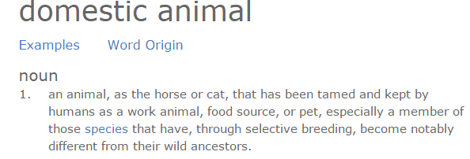
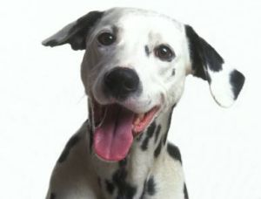
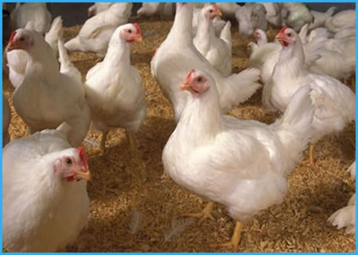
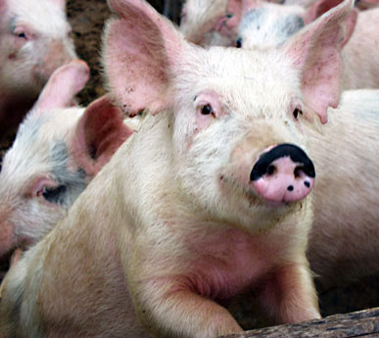
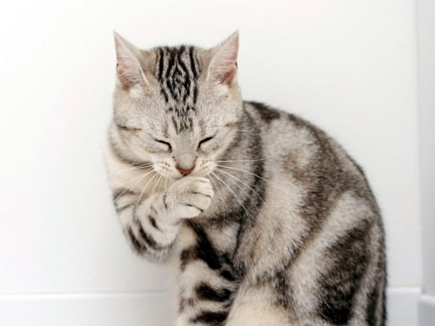
Artificial Selection
Domestic animals are animals that have a history of living with people.

Slide 7
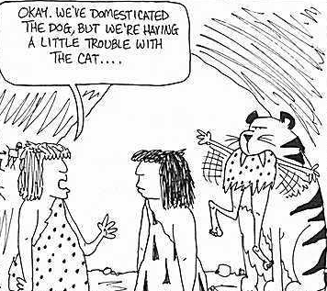

Slide 8
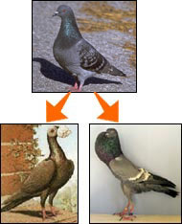
In order to increase the odds of animals and plants having the specific characteristics that we want, humans have developed the process known as ARTIFICIAL SELECTION AKA SELECTIVE BREEDING.
Artificial selection involves picking the animals with the traits that you want and breeding them with one another, then mating the offspring which express these traits until you get the desired look
The carrier pigeon (bottom left) and the Brunner pouter (bottom right) were derived from the wild rock pigeon (top).

Slide 9
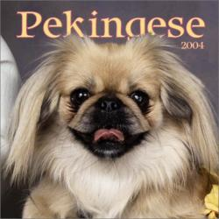
Sometimes artificial selection can produce health issues.
e.g. Pekingese dogs have flattened faces so they often have breathing problems.
Beautiful Monsters

Slide 10
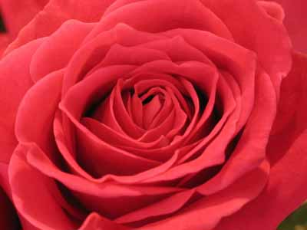
Artificial selection can be used to increase a single trait or to combine two or more desirable traits in a plant or animal.
e.g. Producing the richest colour and most fragrant roses.

Slide 11
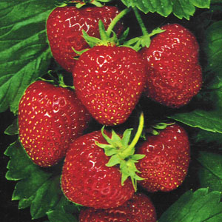
Plant hybrids are a cross between different species that are usually within the same genus. These hybrids may have high food production or have a tolerance for environmental conditions such as freezing temperature.
e.g. This is a commercial strawberry plant, a cross between Fragaria chiloensis and F. virginiana.
Breeding Strawberries History

Slide 12
Artificial selection can have results over a relatively short period of time but natural selection usually take much more time.

Slide 13
Activity
Look at the dog breed chart on the next page as well as the link below. Examine each lineage and think about the traits of each breed. Determine what each type of dog was bred to do. Write down your ideas.
Dog Breeds

Slide 14
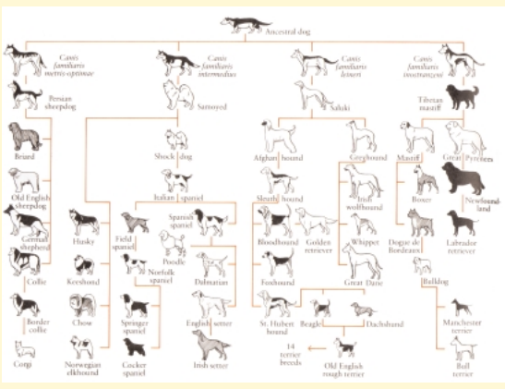

Slide 15
What other animals have we bred for specific characteristics? Collect photos and caption each one to show several examples.

